Slide 1

DEPARTMENT OF COMPUTER SCIENCE AND ENGINEERING
Codegene - Skill Enhacement Project
DOCTOR APPOINTMENT BOOKING WEB APP
PROJECT STUDENT
U SHAINDHAVI, 43111288

Slide 2
AGENDA
Abstract
Existing System
Proposed System
Advantages
Disadvantages
Hardware Requirements
Software Requirements
Modules
Module Description
Sample Output
Conclusion

Slide 3
ABSTRACT
The project “ DOCTOR APPOINTMENT BOOKING WEB APP” is an online doctor appointment booking system that bridges the gap between patients and healthcare professionals.
It helps patients book consultations with doctors in real-time through a user-friendly digital interface.
The platform minimizes hospital waiting time and eliminates manual scheduling errors.
Doctors can manage their appointments through a dedicated dashboard integrated with live updates.
It provides a paperless, efficient, and accessible healthcare experience.

Slide 4
EXISTING SYSTEM
Manual Appointment Process
Patients must physically visit hospitals or call receptionists for booking appointments.
Records are maintained manually increasing chances of human error.
No automated mechanism to track or manage doctor availability.
Appointments often clash, causing overbooking and patient frustration.
Time-consuming for both doctors and patients.
High risk of data loss due to paper-based records.

Slide 5
PROPOSED SYSTEM
The proposed system introduces a digital appointment scheduling platform.
Patients can book appointments anytime, anywhere via a web browser.
Doctors can view upcoming appointments on their dashboards.
Enhances operational efficiency with a modern and scalable UI built in React.
Secure login for both patients and doctors using Supabase Auth.
Smart scheduling that prevents double-booking.
Real-time data synchronization between patient and doctor dashboards.

Slide 6
ADVANTAGES
Saves time and reduces hospital crowding.
Accessible from any device with an internet connection.
Provides real-time booking and cancellation options.
Ensures secure and organized digital record storage.
Enhances hospital management efficiency and patient satisfaction.
Secure record storage ensures privacy and reliability.
Improves patient satisfaction and healthcare experience.

Slide 7
DISADVANTAGES
Needs continuous internet connection for real-time operation.
Requires system maintenance and periodic updates.
New users may face a small learning curve initially.
Dependent on Supabase server uptime and connectivity.
Potential data risks if authentication is not properly secured.

Slide 8
HARDWARE REQUIREMENTS
Any PC/Laptop/Smartphone with an updated browser.
Minimum 2 GHz processor, 4 GB RAM, 500 MB storage.
Stable internet connection (Wi-Fi or data).
Server setup or cloud hosting for Supabase backend.
Basic networking hardware (router/modem).

Slide 9
SOFTWARE REQUIREMENTS
Frontend: React.js, Tailwind CSS, Vite.
Backend: Supabase (PostgreSQL + Authentication).
Languages: TypeScript / JavaScript.
Tools: Node.js, npm, VS Code, Git.
Libraries: ShadCN UI, Sonner, Lucide-react icons.

Slide 10
MODULES
Authentication Module – Secure login for patients and doctors.
Doctor Management – Lists specialties and availability.
Appointment Booking – Date, time, and slot selection.
Doctor Dashboard – Real-time schedule monitoring.
Database Module – Manages and syncs data via Supabase.

Slide 11
Module Description
Authentication: Validates user credentials securely.
Booking Section: Core interface for scheduling appointments.
Doctor Dashboard: Displays current bookings with updates.
Calendar Integration: Simplifies date/time selection visually.
Notification System: Confirms actions through live pop-ups.

Slide 12
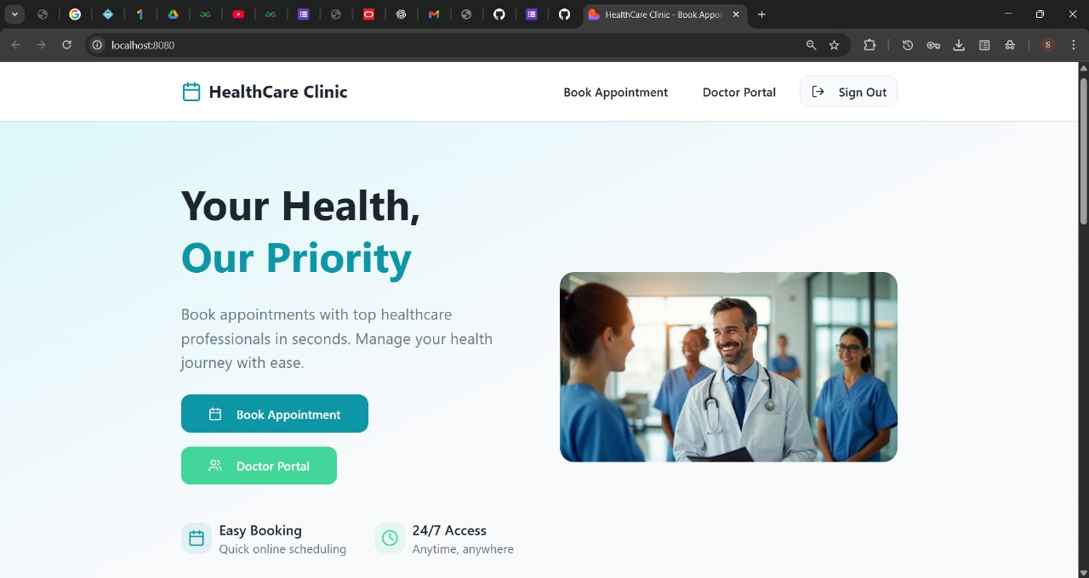
SAMPLE OUTPUT

Slide 13
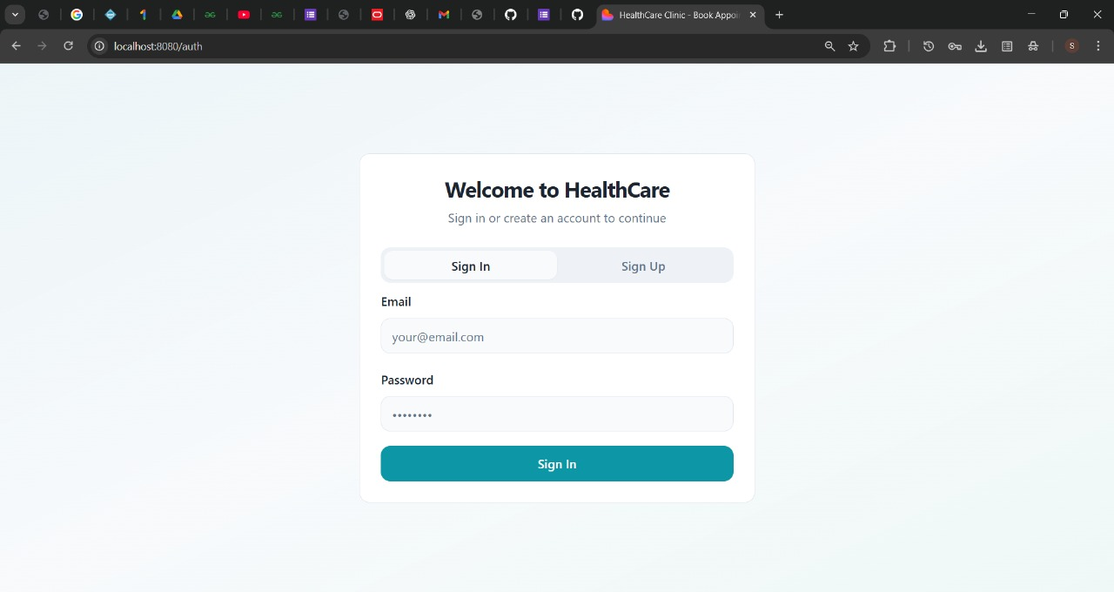
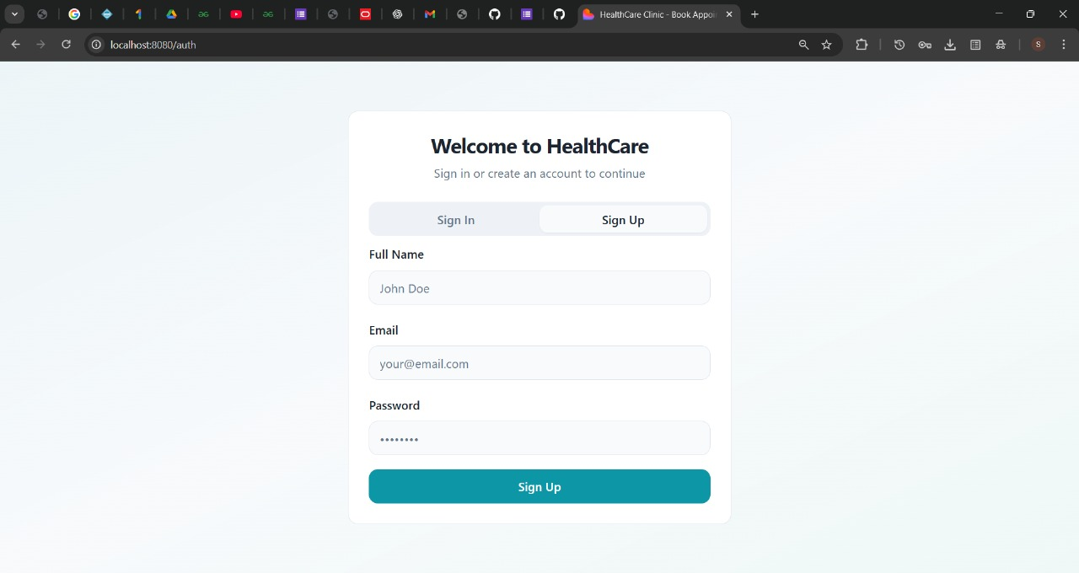

Slide 14
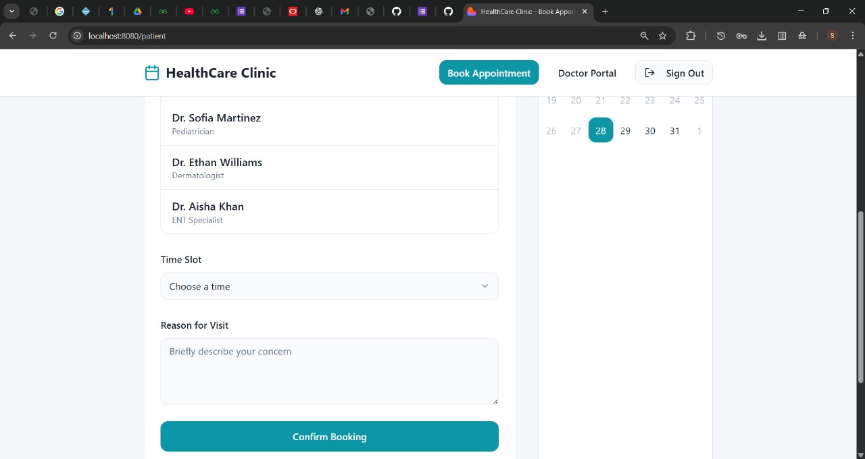

Slide 15
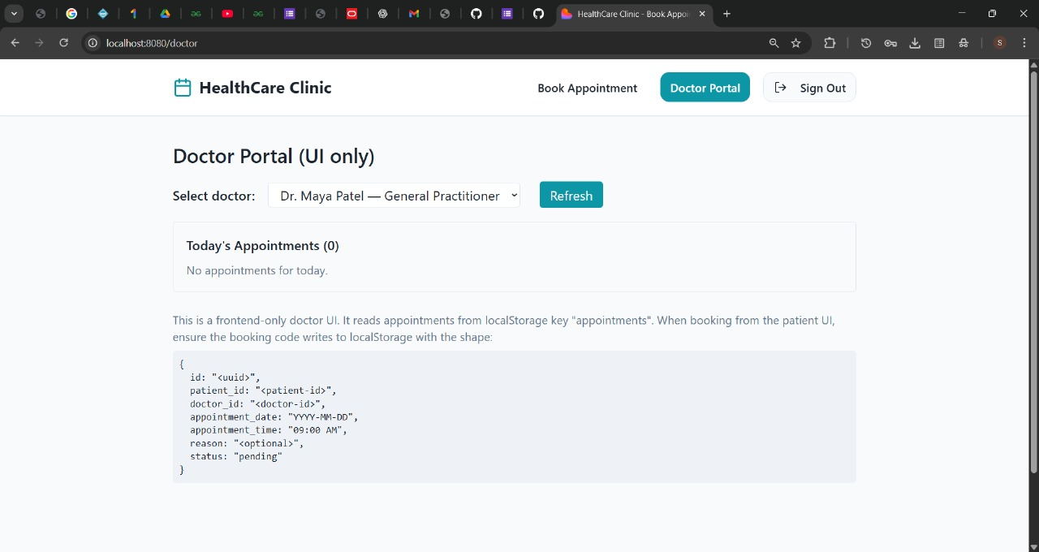

Slide 16
CONCLUSION
Achieves efficient and paperless appointment management.
Reduces workload for hospital staff and improves accuracy.
Enhances doctor-patient communication through technology.
Secure, scalable, and future-ready healthcare solution.
Can be expanded with payment gateway and AI-based recommendations.

